Slide 1
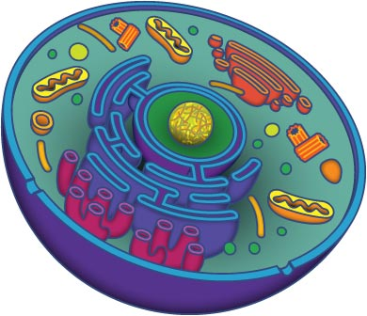
Cell Equal Living
1. Investigation

Slide 2
Think
How can you determine if something is living or non living?
How would you categorize a cat, living or non living?
3. How would you categorize wood?
4. How would you categorize a rock?

Slide 3
Post- Discussion
How were you able to determine if something was living?
How were you able to determine if something was once living?
How were you able to determine if something was non living or never living?
Why do you need a microscope to identify if something is living?

Slide 4
Think Again!
Can you design a similar investigation that would involve an independent and dependent variable?

Slide 5
Goal for today (9/30)
Observe one more specimen.
Draw what you observe
Finish steps 1 through 9 on the handout.
For analysis: write at least two sentences. Use specimen as (data) examples.

Slide 6
Goal
Write the C- E- R
Hand in your paper at the end of the period

Slide 7
C- E- R (10/3)
What was the claim?
What specimen did you observe? These are your data.
Use data to support your claim.
Compare the observation of living and nonliving things.
Based on all the observations what is your reasoning?
Use the rubric to finish this part (C-E-R). It will be graded as a 90% grade.
The rest of the paper will be graded as daily work (10%)

